Slide 1
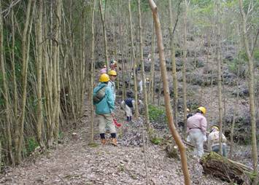
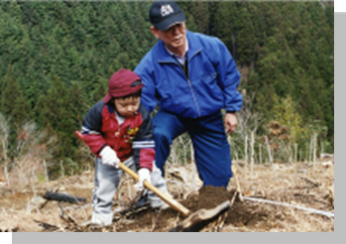
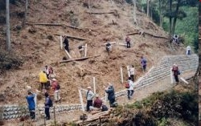
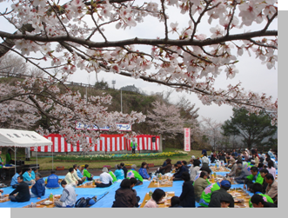
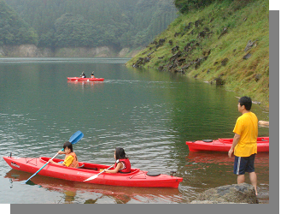
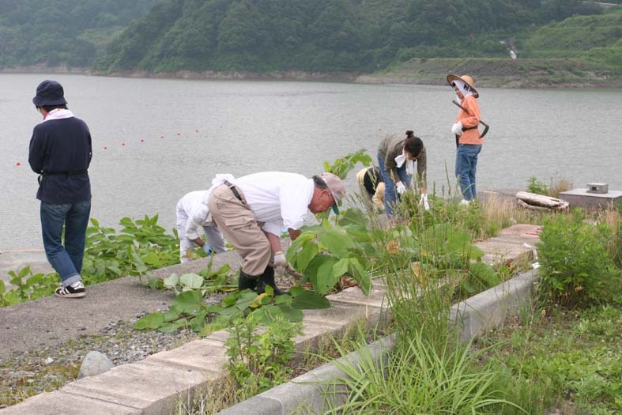
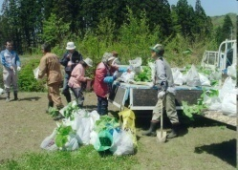
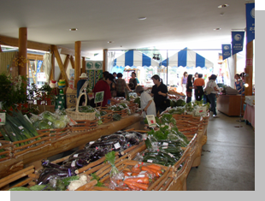
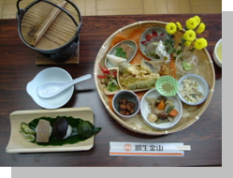
Current Conditions & Issues of the “Measures for Reservoir Area Development”
- For Development of Attractive Reservoir Area -
Reservoir Area Development Office, Water Resources Policy Division, Water Resources Department, Water and Disaster Management Bureau, Ministry of Land, Infrastructure, Transport and Tourism, Japan
Notes:
0

Slide 2
What are the “Measures for Reservoir Area Development”?
What is the “Special Measures Law for Reservoir Area Development”?
Non-structural Measure / Community Development
Reservoir Area Development Fund
National Non-structural Measures
1
Notes:
1

Slide 3
What are the “Measures for Reservoir Area Development”?
Construction of a dam, etc. (including water level regulating facilities of lakes and
marshlands) causes great impact to inhabitants as well as the local communities by
resulting in submersion of many houses, agricultural land, forests, and the like.
Because of it, it is an important issue to improve stability in inhabitants’ livelihood
and public welfare through ;
① Taking measures for resettlement of habitation of those who are involved to
submersion of their homes, etc., and
② Developing living environment and industries in the area concerned.
In order to promote construction of a dam, etc., measures for reservoir area development are
taken by combining various policies for development of the area with a central focus on;
① Compensation by a builder of the dam, etc.;
② Development of the area under the Special Measures Law for Reservoir Area Development ;
③ Measures for resettlement of habitation by the Reservoir Area Development Fund.
○ In the Measures for Reservoir Area Development, it is important to deal with;
① Existing measures taken during the planning /construction of the dam, and
② Measures for sustainable maintenance/activation of the reservoir area after the operation of the dam.
(More than 2,700 dams have already been completed)
○ It is required to develop the reservoir area by the way that the community utilizes the reservoir
of the dam and the facilities that are arranged to enhance the utilization of the area as
its own resources and relevant organizations supports such activities in cooperation with the
community.
2

Slide 4
Particularity of Impact on the Inhabitants in the Areas Submerged by Construction of a Dam
For inhabitants in the submerged area, the impact they receive is not caused only by
submersion of their lands and homes but also by disappearance of community that has
supported foundation of their livelihood.
The impact brought about by the fact that the area in where a dam is planned to construct is
the rural district, where, generally, depopulation as well as aging of population is being
progressed.
i). There is little opportunity that the inhabitants, whose home and land have been
submerged, could find a new house or a new job around the area concerned;
circumstances are difficult them to rebuild their livelihood there.
ii). There is an aspect that construction of a dam causes depopulation and aging;
circumstances are difficult for the inhabitants, who have remained in the area, to keep up
their livelihood there.
iii). Generally, the financial base of municipalities in the submerged area is fragile; they may
receive large impact of depopulation and aging resulting from the construction of the dam.
The impact brought about by off-balance between areas, which is caused by the fact that the
area, which receives negative effects from the construction of a dam, and the area that
receives benefit from the said dam are different.
Meticulous measures for resettlement of habitation and local development are required.
3

Slide 5
History of the “Measures for Reservoir Area Development”
(before the Special Measures Law for Reservoir Area Development has been established) ①
In the planning of Ogochi Dam (in Okutama-Cho, Tokyo) formulated before the
World War II, a large scale submersion had been estimated; from this, an issue on inhabitants,
whose land and houses would be submerged, became obvious.
○After the World War II, to cope with requirements for water-utilization and flood control, a
large size and multi-purpose dam has dominated; with this, the scale of the submerged area
became larger, too.
※ Ensuring the electric power for post-war reconstruction → Rapid increase of power
dams (Electric Power Development Co., Ltd. has been established in 1952)
※ Severe flood occurrence in post-war era →Having caused an idea to control flood by a
dam → Special Multi-Purpose Dam Law has been enacted in 1957
○ Protest campaign against construction of Matsubara/Shimouke Dam in 1950s.
※ A vision for resettlement of habitation had not been shown to inhabitants, whose lands
and houses would be submerged; this was the main reason that had caused severe protest
campaign.
With the above-mentioned events as a turning point, the following policies have been
formulated.
▽ “Outline of Loss Compensation Standard with Land Acquisition for Public Use”:
established in 1962 (Loss Compensation)
▽ “Outline of Public Compensation Standard with Execution of Public Works”: established
in 1967. (Public Compensation)
Loss Compensation: complete compensation of the property value.
Public Compensation: restoration of functions with similar facilities
4

Slide 6
History of the “Measures for Reservoir Area Development”
(before the Special Measures Law for Reservoir Area Development has been established) ②
As mentioned above, general rules on compensation with public works have been established;
however, considering from particularity with construction of a dam, granting compensation
only was not enough as the response to those concerned, whose lands and houses would be
submerged (local residents, regional governments).
▽ Special measures as given below were considered necessary:
① Ensuring resettlement of habitation of residents, whose properties would be submerged.
② Preventing occurrence of depopulation caused by the construction of the dam.
③ Preventing the regional governments from worsening their financial conditions.
④ Adjusting the conflicting interests caused by the construction of the dam.
○ History until the Special Measures Law for Reservoir Area Development has been established.
1966: Request from Oita Prefecture (response to the situation in Matsubara/Shimouke Dam)
1969: Request from Association of Prefectural Governors (response to the construction of
Yanba Dam).
1972: Inauguration of Tanaka Cabinet
• Biwa Lake General Development Special Measures Law has been established →
Formulation of general development plan / increasing contribution percentage by the
state / Burden to be shouldered by the downstream/measures for resettlement of
habitation.
• Another request from Association of Prefectural Governors
• Conference of Parliamentary Vice Minister related to Reservoir Area Development
Issues
1973: Special Measures Law for Reservoir Area Development has been enacted.
5

Slide 7
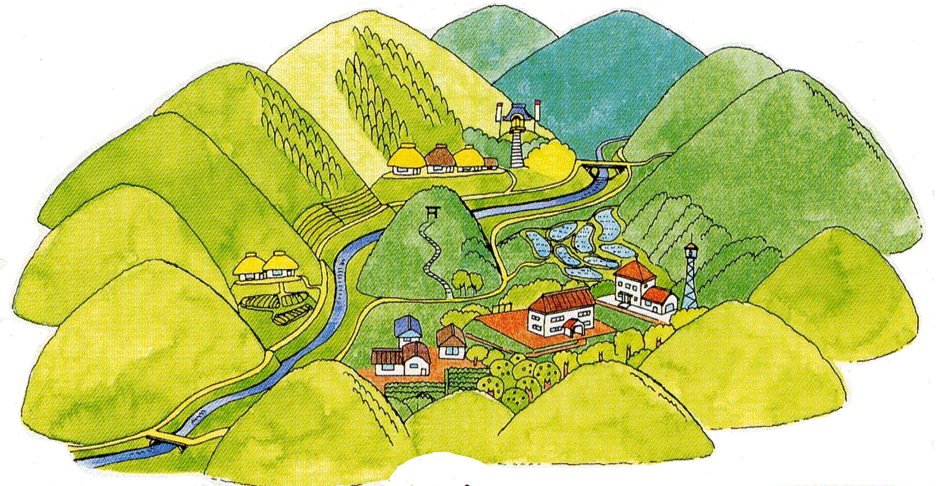
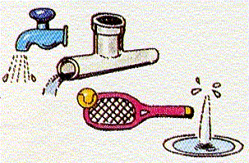
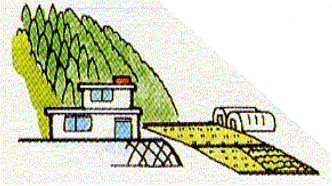
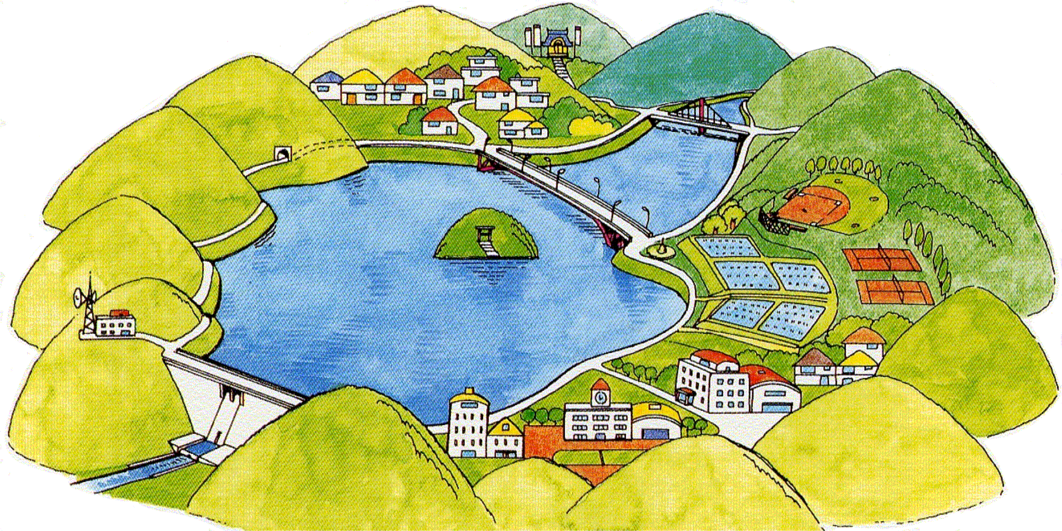
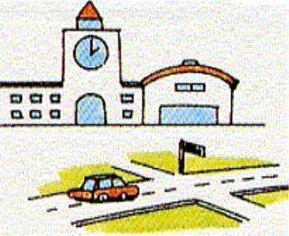
Overall Picture of the “Measures for Reservoir Area Development” (Image)
■Measures for resettlement of
habitation by Reservoir Area
Development Fund
・Arranging an advisor for resettlement
of habitation
・Subsidy for interest to acquire
substitute land
・Supporting urban development;
developing water source forest.
Before the construction
of a dam
■Non-structural measures for activation of reservoir area
・Training to foster a leader for
activation of reservoir area.
・Dispatching an advisor on
measures for reservoir area development.
・Training of an advisor for resettlement of
habitation.
・Survey on activation of reservoir area
■Renovation Project under Special Measures Law for Reservoir Area Development
・Maintenance of
living environment
・Improvement of
industrial infra.
・Welfare facility
・Water quality preservation facility
・Disaster prevention facility
・Sightseeing, recreation facilities, etc.
■Compensation by the builder of the dam
General
Compensation
・Housing
・Agricultural land
・Forest
After the construction
of a dam
Public
Compensation
・Roads
・Municipal offices
・Schools
○Designated dam, etc.
96 dams plus Kasumigaura
○Determination of
Maintenance plan
89 dams plus Kasumigaura
（as of January 2010）
6

Slide 8
What are the “Measures for Reservoir Area Development”?
What is the “Special Measures Law for Reservoir Area Development”?
Non-structural Measure / Community Development
Reservoir Area Development Fund
National Non-structural Measures
7
Notes:
7

Slide 9
Points of the Special Measures Law for Reservoir Area Development
Purpose:
As to the water source area, where the basic conditions are changed remarkably by the construction of a dam, ensuring stability in inhabitants livelihood and improving public welfare through improvement of living environment, arrangement of industrial infrastructure and prevention of water quality in the dam from contamination, so as to promote the construction of a dam and to contribute to development of water resources and preservation of the national land.
Dam, etc, to be the target of application of the said law:
Dams as well as large scale development of water level regulating facility of ponds and marsh lands constructed by the central government, local governments and Japan Water Agency, with which more than 20 houses and more than 20 ha. of agricultural lands are submerged (in Hokkaido, the area of submerged agricultural land should be more than 60 ha.).
As to dams, application of the law depends on the scale of submersion regardless of the scale of the dam itself and its functions; for example, the flood control dam can also be the target.
Scheme and support policies:
Based on the requirements from the local community, the target dam as well as the reservoir area is specified and the reservoir area development plan is decided, in which various projects in the area such as land improvement, forest conservation, road construction, etc. are provided; based on them, projects for improvement of the local living environment, development of industrial infrastructure, prevention of water contamination in dams and reservoirs, etc. are implemented.
In addition, measures needed for activation of the water source area such as special treatment concerning taxes are taken.
8

Slide 10
Mechanism of the Special Measures Law for Reservoir Area Development
Purpose: Promoting construction of dams, etc. by improving living environment and developing
industrial infrastructure in water source areas.
Specifying the target dam (target of the Special Measures Law for Reservoir Area Development)
Criteria for specifying a dam → a dam with large scale submersion: submerged houses of more than 20 or submerged area of agricultural land of more than 20 ha. (more than 60 ha. in Hokkaido area).
By the request of governors, the central government designates by means of the government ordinance.
Specifying reservoir area (target of the Special Measures Law for Reservoir Area Development)
Application by governors
○ Designated by the Minister of Land, Infrastructure, Transport and Tourism
○ Segmented sections of municipalities, etc., that border the reservoirs
Deciding Reservoir Area Development Plan
(= concrete contents of the plan)
The draft is formulated by governors
○ Designated by the Minister of Land, Infrastructure, Transport and Tourism
○ 24 categories of project such as roads, land improvement, sports/recreation facilities
Implementation of development projects by the central as well as local governments
[Merits of Special Measures Law for Reservoir Area Development】
○Consideration given by the central government in adoption of the public works.
○For the large scale submersion dam (houses submerged of more than 150 or agricultural land submerged
of more than 150 ha), percentage of national government subsidy ratio for the project is increased.
○A part of the project costs (burden shouldered by local governments) is borne partially by benefitted area in
the downstream.
○ Both central and local governments have duties to make efforts for activation of water source areas.
9

Slide 11
Merits of the Special Measures Law for Reservoir Area Development
Projects with national government subsidy, which is positioned as the development project based on the reservoir area development plan, shall be adopted by priority (Article 5 ~ Article 7)
②Measures shall be taken so that a part of the costs required for development of the project can be
borne by beneficiaries in the downstream (Article 12)
③Measures shall be taken so that percentage of national government subsidy may be increased for the dam with large-scale submersion(Article 9)
This provision is applied to the dam, with which more than 150 houses or more than 150 ha. of
agricultural land are submerged (in the case of the dam, whose location is not in the area of prefectural
government that receives remarkable benefits from the dam; the dam with submerged houses of more than
75 or submerged agricultural land of more than 75 ha.).
▽Increase in the percentage of national government subsidy ratio differs by projects and the time when the said dam is designated as the target.
(Example: Road (in the case of the designated dam on and after 1993):
- Usual subsidy ratio: 1/2
- Special subsidy ratio: 5.5/10 (roads in the area where has heavy snow falls under severe cold weather:
2/3;
- High standard road: 6/10)
④Special measure on tax (Article 13 and Article 14)
i) Measure for compensation to decrease in profits arising from taxation on a different basis of the fixed assets tax related to manufacturing industry and hotel business located in the water source areas.
ii) Specially recognized depreciation of income tax and corporate tax related to manufacturing industry and hotel business located in the water source areas.
Assistance for resettlement of habitation by relevant authorities (Article 8)
10

Slide 12
Target Projects of Reservoir Area Development Plan
• Land improvement* • Jointly used facilities
• Forest conservation* • Natural park
• Flood control* • Community center, etc.
• Roads* • Sports/recreation facilities
• Small water supply system* • Nursery center, etc.
• Sewage system • Aged people’s welfare center
• Compulsory education facilities* • Regional welfare center
• Clinics* • Cable broadcasting telephone, radio tel.
• Development of residential sites • Fire defense facilities
• Municipal housing • Stockbreeding wastewater treatment plant
• Forest roads • Human waste treatment plant
Forestation • Garbage disposal plant
Total 24 kinds of projects (categories)
*: Target project entitled for raising national government subsidy ratio
11
Notes:
水没戸数の多いダムに関し、補償とあいまって、公共施設整備を行うことが主眼。
これにより、同一市町村内の他地区に移転する水没地域住民の生活の利便性が図られる。

Slide 13
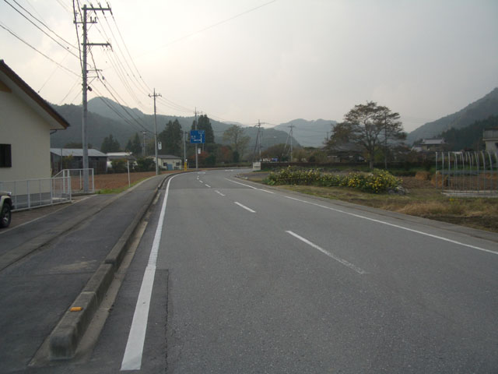
Reservoir Area Development Plan and Compensation Work (combined work)
As to the public facilities that will be submerged by the construction of a dam, a compensation work
will be implemented by the builder of the dam. The said compensation work does not included in the
Reservoir Area Development Plan.
If sufficient effect cannot be gotten only by the compensation work, there is a case that the compensation work and the project of reservoir area development plan are executed together as combined work.
Compensation work
Widening portion
(by reservoir area
development plan)
12

Slide 14
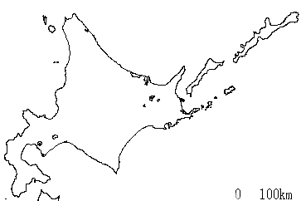
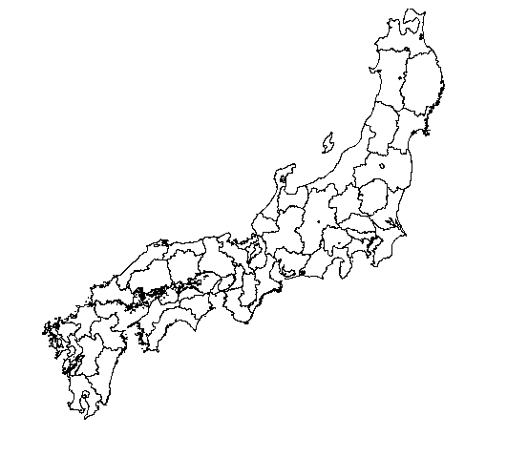

Designated Dams under Special Measure for Water Source Area Law
Omonogawa River, Tamagawa Dam
※Iwaki River, Aseishigawa dam
Mabuchi River, Oshida Dam
※Iwaki River, Tsugaru Dam
Niidagawa River, Yomasari Dam
※Yoneshiro River, Moriyoshizan Dam
※Kitakami River, Gosho Dam
※Ishikari River, Takisato Dam
Omono River, Omatsugawa Dam
Kitakami River, Isawa Dam
Ishikari River, Aibetsu Dam
Naruse River, Naruse Dam
Kitakami River, Yanagawa Dam
※Ishikari River, Yubari Shuparo Dam
Ishikari River, Chubetsu Dam
Mogami River, Sagae Dam
Naruse River, Minamikawa Dam
Sarugawa River, Biratori Dam
Arakawa River, Yokokawa Dam
※Kitakami River, Naganuma Dam
※Ishikari River, Tobetsu Dam
Aganogawa River, Okawa Dam
Sarugawa River, Nibutani Dam
Aganogawa River, Shinmiyakawa Dam
※Abukuma River, Shichigashuku Dam
Tone River, Kiryugawa Dam
※Abukuma River, Surikamigawa Dam
Shiribeshi-Toshibetsu River, Pirika Dam
Mukogawa River, Mukogawa Dam
※Tone River, Yanba Dam
Mano River, Mano Dam
Sendaigawa River, Tono Dam
Fuji River, Arakawa Dam
※Abukuma River, Miharu Dam
Kakogawa River, Gongen Dam
Fuji River. Shiokawa Dam
※Tone River, Yunishigawa Dam
※Yoshii River, Tomata Dam
※Tedorigawa River, Tedorigawa Dam
※Tone River, Kawaji Dam
Hino River, Gasho Dam
Daishojigawa River, Kutani Dam
Hiigawa River, Obara Dam
※Tone River, Nanma Dam
Hiigawa River, Shitsumi Dam
Kuzuryu River, Asuwagawa Dam
Arakawa River, Kakkaku Dam
Numata River, Fukutomi Dam
Kuzuryu River, Yoshinosegawa Dam
Arakawa River, Urayama Dam
Ozegawa River, Yasaka Dam
※Yodo River, Hiyoshi Dam
※Tone River, Kasumigaura
Red: Development plan has
completed.
Blue : Development plan is being
executed.
Black: Development plan has not
been decided.
*mark: Target project of raising
natinal government
subsidy ratio.
(as of January 2010)
Nishiki River, Ikimigawa Dam
Mukogawa River, Aono Dam
Shimada River, Nakayamagawa Dam
※Sagami River, Miyagase Dam
Nishiki River, Hirase Dam
Yoro River, Takataki Dam
Suetakegawa River, Suetakegawa Dam
Obitsukawa River, Kameyama Dam
Koyagawa River, Shin-Yunohara Dam
Arakawa River, Takizawa Dam
Haraigawa River, Irahara Dam
Oigawa River, Nagashima Dam
Nakagawa River, Gokayama Dam
Kiso River, Agigawa Dam
Kiso River, Shin-Maruyama Dam
※Kasegawa River, Kasegawa Dam
Koutougawa River, Kabagawa Dam
Toyogawa River, Shitara Dam
Kawatanakawa River, Ishiki Dam
※Kiso River, Tokuyama Dam
Yoshino River, Tomisato Dam
Kamitagawa River, Banba Dam
Designated dams
96 dams plus Kasumigaura
Among them, target projects of raising national government subsidy ratio are:
26 dams plus Kasumigaura
Dams with which development plan has already been decided:
89 dams plus Kasumigaura
Ashidagawa River, Hattabara Dam
Yodo River, Nyu Dam
Chikugo River, Koishiwaragawa Dam
※Gonokawa River, Haizuka Dam
Yodo River, Daidogawa Dam
Kamo River, Nika Dam
Yodo River, Kawakami Dam
Hijikawa River, Yamatosaka Dam
Kushidakawa River, Hachisu Dam
※Kikuchi River, Ryumon Dam
Hijikawa River, Nomura Dam
Yodo River, Nunome Dam
Oita River, Oitagawa Dam
※Kinokawa River, Ohtaki Dam
※Kumagawa River, Kawabegawa Dam
Yamakunikawa River, Yabakei Dam
Yodo River, Aigawa Dam
Chikugo River, Ohyama Dam
Yamatogawa River, Takihata Dam
※Hidakagawa River, Tsubayama Dam
13
Yodo River, Hitokura Dam
13
Kakogawa River, Dondo Dam

Slide 15
What are the “Measures for Reservoir Area Development”?
What is the “Special Measures Law for Reservoir Area Development”?
Non-structural (Soft) Measure / Community Development
Reservoir Area Development Fund
National Non-structural Measures
14
Notes:
14

Slide 16
Total Urban Development by Strengthening Non-structural Measures
Structural Measures
Non-structural measures
Goods
Human
Foundation/Facility
Organization/System
Development
Total urban development
Management/Utilization
Living environment
Mechanism/Contrivance
Industrial infrastructure
Independent and sustainable urban development
Knowledge/Information/ Knowhow
Place / Bases
Activity
Public
Public participation
Quantitative fulfillment
Qualitative fulfillment
15

Slide 17
Image of Non-structural Measures in Reservoir Area
Main body for execution
Image of Non-structural measures
▼Formulating integrated strategies
・Regional branding strategy
Municipal government office (municipalities)
・Development of mechanism of economic environment
・Regional management strategy
3rd Sector
・Grand design
・Organic ties of hard (facility, etc.) with soft (regional development activity)
・Formulating promotion measures
Public Corporation
・Research & study
・Study and analysis of preceding and similar case examples
Tourist Agency
▼Information transmission
・Publicity, marketing
・Development of a market (trade outlet) , induction of tourists
Chamber of commerce & industry
・Enlightening on importance of water source areas
・Analysis of needs of tourism (consumers)
▼Human resource development
・Carrying out & participation in workshop, training, etc.
Junior chamber
・Fostering a leader & developing a system
・Inviting an expert
NPO
▼Ties between up & down streams /cooperative activities
・Ties with various people, implementing experience-based events
School / PTA
▼Water source area and water source forest preservation
・Learning on environment, life system conservation, planting, tree thinning, landscaping, water culture, etc.
Bodies for regional activities
▼Development of industry and tourism
Volunteers in the region
・Pilot shop, exhibition of products, etc.
・Development of special products and tourism
・Green tourism, experience-based model tour
16
Notes:
16

Slide 18
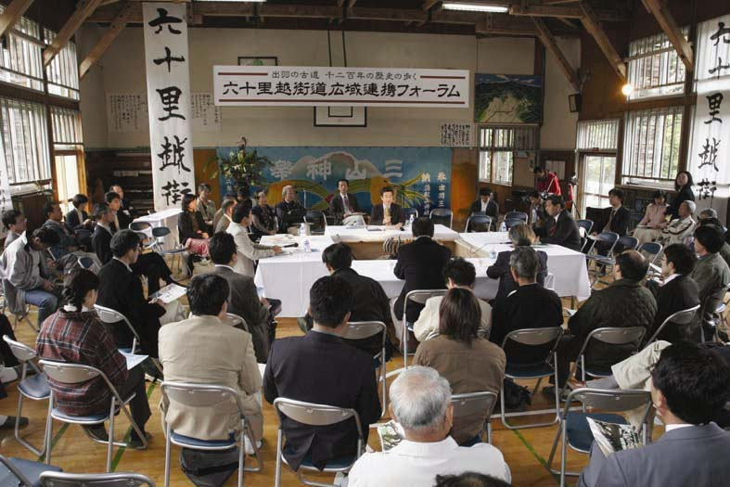
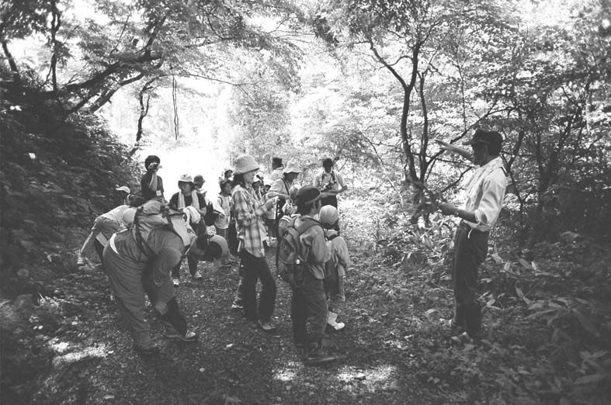
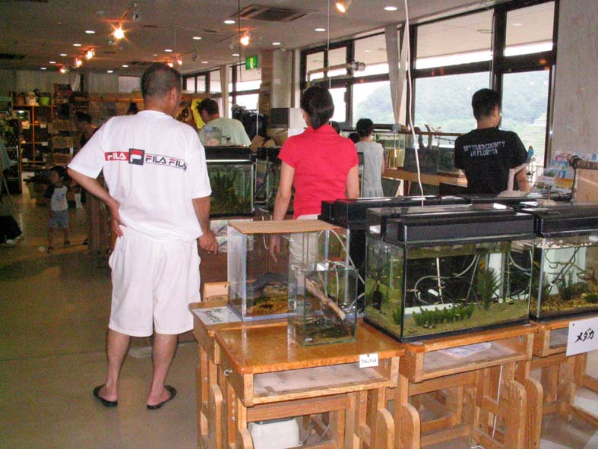
Community Development in Reservoir Area ①
Human Resources Development
Ties between up & downstream
Human resources development
Development of tourism
Environment conservation / beautification campaign
Environmental education
Fostering traditional culture
Regional Life
Ties with Exterior Parties
Forest conservation
Research and conservation of cultural assets
Promotion of use of reservoir
Effective use of base facilities
Water quality preservation
Development / sales of special products
Information transmission
Resources Utilization
17
Notes:
17

Slide 19
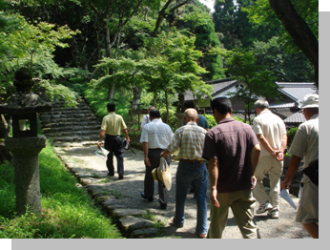
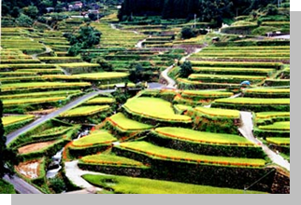
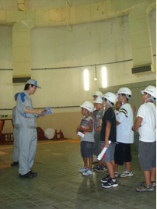
Community Development in Reservoir Area ②
・Sunset appreciation
・Volunteer for
forest work
Natural resources utilizing type
・Forest therapy
・Experience of collecting wild plants
・Terraced rice field owner system
・Walking in
countryside
・Experience of raising vegetables / mushrooms
Prolonged Stay
Integrated Type
（Staying in farm house, etc.）
Leisure type
Active type
・Experience of canoe on the dam reservoir
・Hot spring
・Experience of processing special products utilizing the space of in closed school
Effective use of facilities type
・Shopping of
special products
・Taking meal at farm restaurant
・Environmental education with utilizing dam facilities.
・Mountain valley village care
18

Slide 20
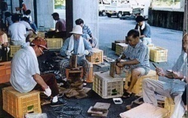
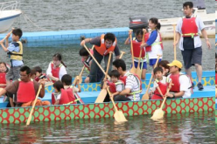
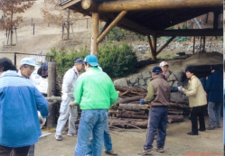
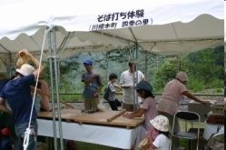
Image of Non-structural (Soft) Measures by linkages between Upstream & Downstream
Reservoir area
Water source forest
Issues in reservoir area
Research, conservation, development of traditional culture
Effective use of regional facilities
Developing tourism resources
Progress of depopulation.
declining birth rate and an
aging population
Declining of regional
dynamism
Increase in abandoned farm land
Devastation of forest
environment
Decreasing in workplaces, by
which one can maintain his
living
Lecture /workshop for human resources development
Forestation by volunteers
Forming an activation plan
Implementing various experience-based tour events
Mechanism of ties (economic circulation)
Implementing environmental education
Analysis of needs of consumers / tourists
Development of products utilizing regional products
地域産品活用
の商品開発
Forming environment conservation plan
Supporting dispatch of manpower with various capabilities
Knowledge, information, money and manpower
Supporting development of pilot shops, transmission of information of products in water source area and its propagation
Needs in urban area
Supporting dispatch of volunteers
Supporting
enlightening activity on environment in water source area
・Building up interest to the environmental issues
・Adhere to safety of foods
・Longing for the country lliving
・Longing for opportunity of getting various recreation
・Building up interest to contribution to society
Supporting utilization of regional resources in water source area
Supporting information exchange with water source area
Urban area
19

Slide 21
What are the “Measures for Reservoir Area Development”?
What is the “Special Measures Law for Reservoir Area Development”?
Non-structural (Soft) Measure / Community Development
Reservoir Area Development Fund
National Non-structural Measures
20
Notes:
20

Slide 22
（４）水源地域対策基金の概要と役割の強化
Outline of Reservoir Area Development Fund
Reservoir Area Development Fund has been established in 1975 by contribution of local governments along the upstream and the downstream, etc. to complement compensation by the builder of the dam as well as that by the Special Measures Law for Reservoir Area Development; so that policies for resettlement of habitation / measures for the local area development may be implemented.
Reservoir Area
Subsidy
Projects implemented by Reservoir
Area Development Fund
◆ Giving subsidies to municipalities that implement the following project
Measures for resettlement of habitation: Arranging an advisor for
resettlement of habitation; Interest rate subsidy for borrowing costs
needed for acquisition of substitute land, etc.
Measures for regional development: Arranging a regional assembly
hall; arranging bus-stop /sign-board for tourists; reconstructing
community roads, etc.
Supporting non-structural (soft) measures: Regional activity by close
ties between upstream and downstream; human resources development,
Development of water source forest: Forest thinning; arranging service
roads; fostering inheritors of forest industry; dissemination,
enlightening, etc.
Flood control
Water supply
Power supply
Burden charge
Benefited area in the downstream
(Reference) Reservoir Area Development Fund
●Reservoir Area Development Fund in designated river systems
●Except for the designated river system, those that got a permit for establishment by the central government
Fund for development of Kiso three River
Reservoir Area
Fund for development of Yodo River
Reservoir Area
Fund for development of Tone River,
Arawaka River Reservoir area
Fund for development of Chikugo River
Reservoir Area
Fund for development of Yoshino River
Reservoir Area
Fund for development of Toyokawa River Reservoir Area
Fund for development of Kinokawa River Reservoir Area
Fund for development of Yahagi River Reservoir Area
21
Notes:
21

Slide 23
What are the “Measures for Reservoir Area Development”?
What is the “Special Measures Law for Reservoir Area Development”?
Non-structural (Soft) Measure / Community Development
Reservoir Area Development Fund
National Non-structural Measures
22
Notes:
22

Slide 24
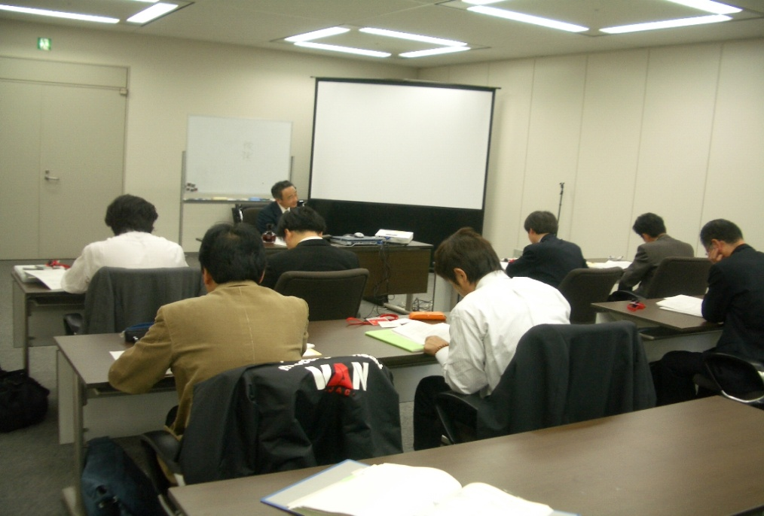
Implementation of Training of an Advisor for Resettlement of Habitation (1990 ~)
(Outline)
Learning and training on the following knowhow is arranged for the staffs of the municipal governments, who will be engaged in consultancy on resettlement of habitation of residents, whose houses and lands are submerged.
① Basic knowledge such as compensation, taxation, etc.
② Case examples on consultancy about resettlement of habitation in other regions.
③ How to deal with issues arisen with the consultancy affairs, etc.
(Curriculum)
• Current state of the Measures for Reservoir Area Development.
• Tax system related to real estates.
• Outline of compensation and case examples.
• How to deal with residents who have to move because their houses and lands will be submerged.
• Exchange of opinion on consultancy for
resettlement of habitation.
23
Notes:
23

Slide 25

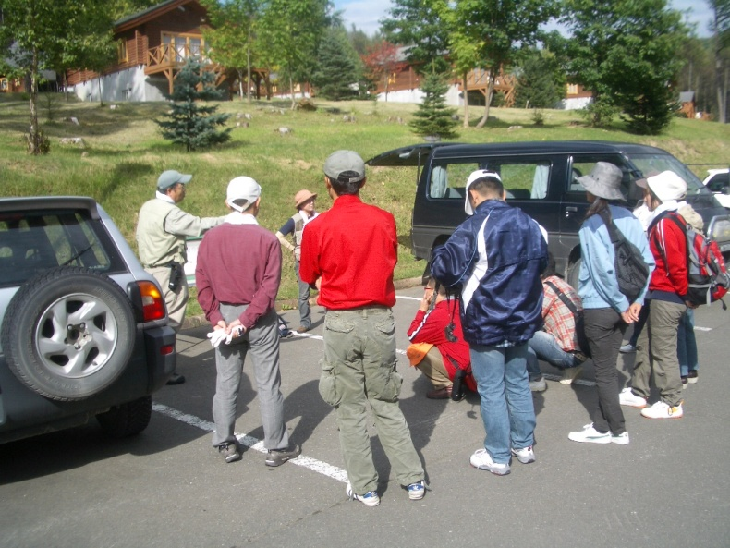
Implementation of Training of Leaders for Activation of Reservoir Area
(2001 ~)
(Outline)
Training of the regional leader intended for the staffs of the municipal governments as well as those of NPOs in the reservoir areas.
(Curriculum)
Presentation, discussion and advice on the issues in the regions, to which the participants are belonging, and the solution of them.
(Scenes from the training)
24
Notes:
24

Slide 26
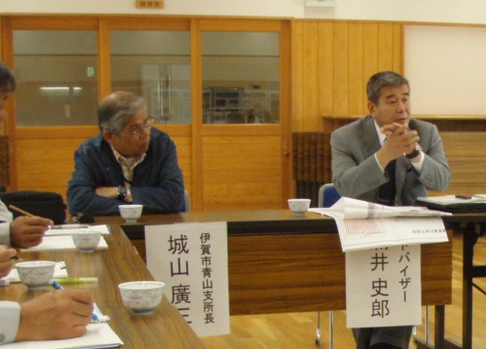
Dispatching Advisors for Measures for Reservoir Area Development (1985 ~)
(Outline)
By the request of municipalities, in where the dam is located, experts on activation of reservoir area or the like are dispatched to the site; the experts give concrete advice on activation of the area such as direction or method of measures to be taken based on discussions with parties concerned.
(1) Actual record of dispatch so far (2010):
[Number of municipalities to which experts were dispatched]: 41
[Number of experts having been dispatched]: 128 (total)
(2) Guiding area:
For the following 6 fields, 15 experts are appointed.
・Tourism/recreation ・Rural development
・Industrial development/invitation of industry
・Measures for resettlement of habitation ・Event planning
・Cooperation among municipalities along river basin area
(3) Current state of dispatch:
Every year, several areas are selected as the target; one expert advisor is dispatched to each area 3 times. Costs needed for the dispatch (remuneration for the advisor, transportation charges, etc. are borne by the central government).
25
Notes:
25

Slide 27
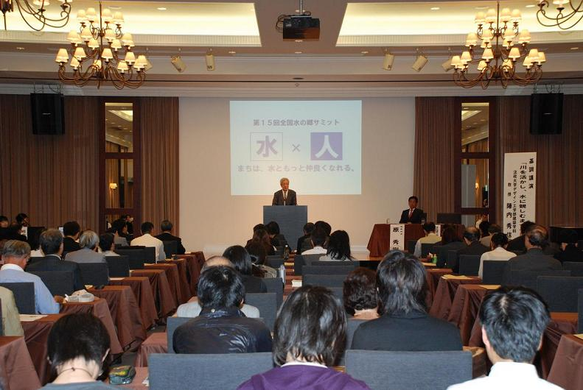
Organizing Nationwide “Mizu no sato (hometown of water)” Summit (1995 ~)
Every year, “Mizu no sato (hometown of water)” Summit has been held with participation of the ‘100 Selected Municipalities’ (Finally 107 areas were selected) that make outstanding efforts in preserving water culture and water environment and get good results in the development of the area with utilizing water resources. Governments of prefectures, towns and villages and NPOs, which have been highly interested in regional vitalization, have also joined the summit. In the panel discussion, case examples of activities in the respective regions are presented and the common issues and the measures to deal with them are discussed.
The 15th Nationwide Riverside Districts Summit has been held on 15th October 2009 at Parkweston in Tokushima City.
Theme: “Water × Human - “Community can be more friendly with water” -
- Organized by: Tokushima City
- In cooperation with: Ministry of Land, Infrastructure, Transport and Tourism / Tokushima Prefecture / Association of Mayors in Tokushima Prefecture / Association of Towns and Villages in Tokushima Prefecture / Water Resource Environment Technology Center / Japan Ground Work Association / National Reservoir Area Fund Council / The Jichi Nippo Co., Ltd., etc.
26
Notes:
26

